Slide 1


WSN localization with Senseless framework
Peter De Cauwer
Tim Van Overtveldt

Slide 2
Overview
Motivation
Applications
WSN as an RTLS
Framework
Algorithms
Conclusion
Q&A

Slide 3
Motivation
What?
To determine the physical coordinates of a group of sensor nodes in a wireless sensor network (WSN)
Due to application context and massive scale, use of GPS is unrealistic, therefore, sensors need to self-organize a coordinate system
Why?
To report data that is geographically meaningful
Services such as routing rely on location information; geographic routing protocols; context-based routing protocols, location-aware services

Slide 4
Overview
Motivation
Applications
WSN as an RTLS
Framework
Algorithms
Conclusion
Q&A

Slide 5
Applications
Environmental monitoring (air, water, soil chemistry, surveillance)
REDWOOD
Home automation (smart home)
Inventory tracking (in warehouses, laboratories)

Slide 6
Overview
Motivation
Applications
WSN as an RTLS
Framework
Algorithms
Conclusion
Q&A

Slide 7
Comparison to Conventional Netwkors
Network | Features
Cellular | •Thousands of nodes •Nodes are appliances outfitted with sophisticated radio transceivers •Mobile nodes greatly outnumber stationary (BS) •BS have unlimited power supply, mobiles are battery-operated •The primary goal is to provide high QoS, along with high bandwidth efficiency
MANET | •Tens to hundreds of nodes •Nodes are appliances outfitted with sophisticated radio transceivers •Nodes are fully mobile •Energy consumption is of secondary importance •Aims to form and maintain a connected multihop network •The goal is to provide QoS (throughput vs. delay)
Bluetooth | •Topology is a star network where a master has up to seven slaves (piconet); there are mechanisms to form a multihop topology •Nodes are appliances and electronic consumer devices •Nodes are short-range mobile •Energy isn’t generally an issue •Goal is to replace cable between devices and provide RF connection between them
WSN | •Hundreds of thousands of nodes •Nodes integrate sensors, processors, transceivers with limited resources •Nodes are generally stationary after deployment •Each node depends on small lowcapacity battery as energy source, and cannot expect replacement •The main goal is to prolong the lifetime of the network

Slide 8

Work environment
VMWare + Xubuntos
Telos Rev. B
Netbeans
Visual Studio

Slide 9
Localization methods
Centralized vs Distributed
Anchor-free vs Anchor-based
Range-free vs Range-based
Mobile vs Stationary

Slide 10
Centralized vs Distributed
Centralized
All computation is done in a central server
Distributed
Computation is distributed among the nodes

Slide 11
Anchor-Free vs Anchor-Based
Anchor Nodes:
Nodes that know their coordinates a priori
By use of GPS or manual placement
For 2D three and 3D four anchor nodes are needed
Anchor-free
Relative coordinates
Anchor-based
Use anchor nodes to calculate global coordinates

Slide 12
Range-Free vs Range-Based
Range-Free
Local Techniques
Hop-Counting Techniques
Range-Based
Received Signal Strength Indicator (RSSI)
Attenuation
RF signal
Time of Arrival (ToA)
time of flight
Time Difference of Arrival (TDoA)
requires time synchronization
electromagnetic (light, RF, microwave)
sound (acoustic, ultrasound)
Angle of Arrival (AoA)
RF signal
Notes:
● Received Signal Strength Indicator (RSSI) techniques measure the
signal power at the receiver; knowing the transmission power and
either the path loss model or the calibration map, loss is translated
into distance or position
● used for RF signals
● Time-of-Arrival (ToA) methods record the propagation time and,
knowing the signal speed, translate it into distance
● Time-Difference-of-Arrival (TDoA) methods record the differences
between the arrival of the same beacon at different sites; knowing
the sites' positions, the sender's position can be inferred
● Angle-of-Arrival (AoA) methods read the angle of reception to a
reference axis and, with the help of known distances, infer
sender's position

Slide 13
Phases
. Determine the distances between regular nodes and anchor nodes. (Communication)
2. Derive the position of each node from its anchor distances. (Computation)
3. Iteratively refine node positions using range information and positions of neighboring nodes. (Communication & Computation)

Slide 14
Phase 1: Calculating Distance to Anchor Nodes
Three algorithms
Sum-dist
DV-Hop
Euclidean
Anchors
flood network
with their
own position

Slide 15
Sum-dist Phase 1:
Anchors
flood network with own position
Nodes
add hop distances
requires range measurement

Slide 16
DV-hop Phase 1:
Anchors
flood network with
own position
flood network with
avg hop distance
Nodes
count number
of hops to anchors
multiply with avg hop distance

Slide 17
Euclidean Phase 1:
Anchors
flood network with
own position
Nodes
determine distance by
range measurement
geometric calculation

Slide 18
Phase 2: Determining Position
Trilateration
uses multiple distance
measurements between
known points
Must solve a set of
linear equation
Triangulation
Law of sines: (sin a)/A=(sin b)/B=(sin c)/C
Min-max
Proximity
Notes:
Trilateration: computes position in n dimensions by measuring distance to n+1 reference points
Triangulation: computes position in n dimensions by having measured one distance and n angles
MinMax: a simplified, power-computation lateration, modelling coverage areas with squares instead of circles
Proximity: determines if objects are near known location
Proximity location senses the presence of an object close to a certain point, using a physical phenomenon of limited range:
– detecting physical contact (pressure sensors, touch sensors, capacitive field detectors) or ID security systems (points-of-sale, computer logins, telephone records)
– monitoring roaming (access point associations)s, using a physical phenomenon of limited range

Slide 19
Phase 2: Min-max
Distance to anchors determines a bounding box
Center of box estimates node position

Slide 20
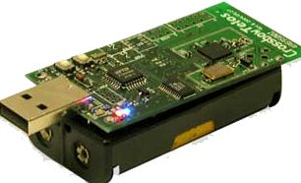
Telos rev. B
Open-source platform voor ontwerpen van WSN.
Wireless sensor platform
Netwerk node
Gateway
Componenten:
USB
Antenna
Processor
Sensors

Slide 21
telosb
TI MSP430 microcontroller with 10kB RAM
IEEE 802.15.4 compliant radio
Integrated temperature, light, humidity and voltage sensor
Programmable via USB interface
TinyOS 2.X compatible
Integrated antenna

Slide 22
TinyOS
TinyOS draait op de TelosB hardware
Open source
Energie efficient
Multi-platform
NesC
Systeem, libraries & applicaties
Geen ontwikkelomgeving
Geen ingeplante debug methode
Printf library
Taal voor structured component based applicaties
Een component voorziet en gebruikt interfaces
Enige connectiepunt naar component (bi-drectioneel)

Slide 23
Ontworpen voor WSNs Event-driven
Small footprint
Low power
Execute – Sleep cycli
Primaire functiesSensing, actuation
Communication

Slide 24
Goede gewoonten
Modulariteit
Code Re-use
3 lagen
HPL, HAL enHIL
Interrupt gebaseerd
Geen polling
Split-phase commando’s

Slide 25
Klein ( x KB )
Geen gescheiden user & system adresruimte
Geen multithreading
Geen virtueel geheugen
Geen processor / geheugenbeheer
Geheugen is statisch, er worden geen variabelen dynamisch toegewezen,
Geheugengebruik geweten na compile-time
Reden: weinig gebruiker interactie
Debugging

Slide 26
nesC extensie = .nc
nesC is een dialect van C
Naamgeving
C suffix: configuratie
Differentieren van een interface
M suffix: module
Bronbestanden gaan eerst door een preprocessor, resultaat: C-code
Gcc

Slide 27
2 type bronbestanden, componenten
Module ( algoritmes )
Configuration
Wired de verschillende componenten aan mekaar
Componenten
Use an interface
Provide an interface

Slide 28
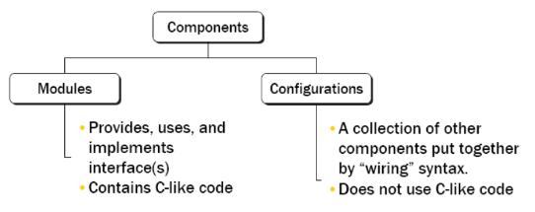
Provide an interface

Slide 29
nesc
Interface
Call a command
Signal an event
Use: MOET alle events afhandelen
MAG een command call uitvoeren
Provide: MOET alle commands afhandelen
MAG een event signaleren
Modules implementeren deze interfaces

Slide 30
Senseless
Software framework
Data interface to the WSNs and GUIs
Dataflow in database
Localization algorithms
in pluggable

Slide 31
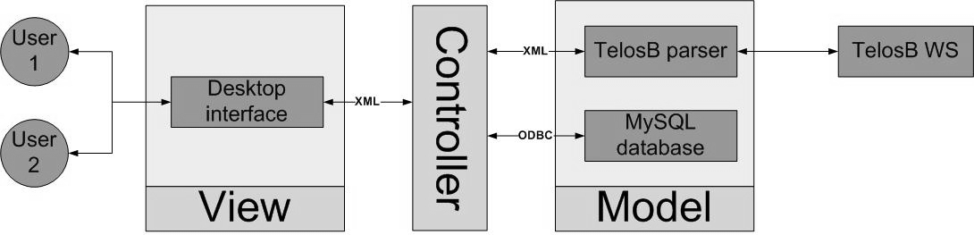
MVC
Model View Controller design

Slide 32
MVC
Advantages:
The adding of new Views en Models
Independance

Slide 33
SOA
Service Oriented Architecture
Advantages:
Modularity and flexibility
Scalability
Reusage

Slide 34
Functionality
WSN
Database
Graphical Unit Interface (GUI)
Controller

Slide 35
WSN
Three different roles:
Root Node
Anchor Node
Blind Node

Slide 36
WSN
Three different messages:
Sensor
Location
Status

Slide 37
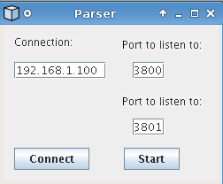
WSN (Parser)

Slide 38
Database
MySQL 5.0 database

Slide 39
Controller
Core of the system
Gatekeeper to the database
Central gathering point
Interface to SCALA

Slide 40
SCALA
RTLS Middleware
Next presentation
Seamless integration of different locating systems
Engine: our system
Middleware: Scala.Core
GUI: SUI

Slide 41
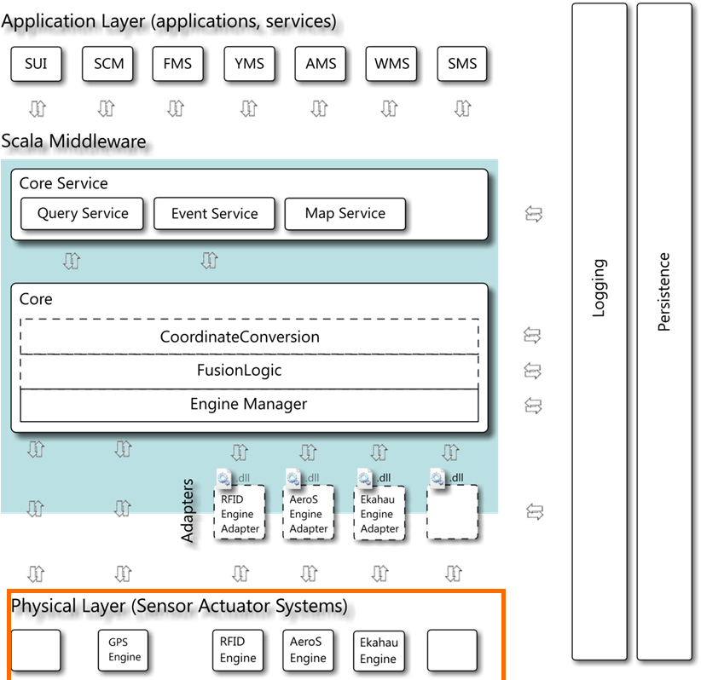
Scala - Engine

Slide 42
Scala
Communication happens via a WCF service
http
Several interfaces
Tag Information
Event
Query
Map
Roughly based on the ANSI RTLS API

Slide 43
Scala - Data
Location
X
Y
Map
Accuracy

Slide 44
Scala - Data
Temperature
Humidity
Light
Button state

Slide 45
GUI
Monitoring
Controlling the WSN:
Active
Anchor node
Coordinates
Sample rate of location and sensor message
Leds

Slide 46
Sensor message
Battery (voltage)
Light
Humidity
Temperature
Button pressed
Mote ID

Slide 47
Location message
Mote id
Anmoteid
VANs
VANr
Hop count
RSSI

Slide 48
Status message
Mote id
Active
AN
Posx
Posy
Samplerate
locRate
leds
power
frequency

Slide 49
Localization

Slide 50
Workflow
Configure anchor nodes with dissemination protocol
Base Mote
attached to PC
Anchor 1
Blind
Anchor 3
Anchor2

Slide 51
Workflow
Confirmation with a status message
Base Mote
attached to PC
Anchor 1
Blind
Anchor 3
Anchor2

Slide 52
Workflow
Broadcast in order to measure RSSI
Base Mote
attached to PC
Anchor 1
Blind
Anchor 3
Anchor2

Slide 53
Workflow
Send back RSSI with the collection protocol
Base Mote
attached to PC
Anchor 1
Blind
Anchor 3
Anchor2

Slide 54
Workflow
Send back value of RSSI
Beacon 1
Base Mote
attached to PC
Request Transmission
and tell how many cycles
of power to loop through
Sends a notification that it is done
This process repeats for each
power level the amount of
times the request asked for
Central
Send back value of RSSI
Broadcast in order
to measure RSSI
Beacon 3
Send back value of RSSI
Beacon 2

Slide 55
Calibration(1)
RSS(d) = - P(d0) – 10 n log(d / d0)
RSS Received Signal Strength[dBm]
P(d0) Path loss in dBm at a distance of d0
n Path loss exponent
d Distance between two nodes[m]
d(0) Reference distance[m]: 1m

Slide 56
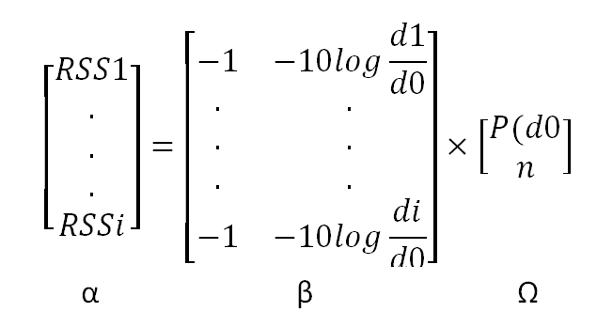

Calibration(2)

Slide 57
Algorithms
Trilateration
Min-Max
CL
WCL

Slide 58
Trilateration
Lateration needs (in theory) distance measurements from:
3 non-collinear references to compute a 2D position

Slide 59
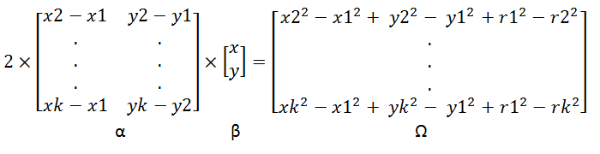

Circle:
(x-x1)² + (y-y1)² = r1 ²
.
.
.
(x-xk)² + (y-yk)² = rk ²

Slide 60
Min-Max
Lateration is computation-heavy; a good simplification models around each anchor node a bounding box and estimates position at the intersection of boxes

Slide 61
Centroid localization
Coarse grained localization
calculate the unknown position as the centroid of the anchor nodes within their communication range
0.0 ; 0.0
3.0 ; 0.0
1.5 ; 1.5
0.0 ; 3.0
3.0 ; 3.0

Slide 62
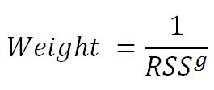
Weighted CL
A weight is coupled to the position of each anchor node by its RSS.
0.0 ; 0.0
3.0 ; 0.0
1
3
2.0 ; 1.0
1
1
0.0 ; 3.0
3.0 ; 3.0

